Slide 1
Programming Logic and Design Seventh Edition
Chapter 4
Making Decisions

Slide 2
Objectives
In this chapter, you will learn about:
Boolean expressions and the selection structure
The relational comparison operators
AND logic
OR logic
Making selections within ranges
Precedence when combining AND and OR operators

Slide 3
Boolean Expressions and the Selection Structure
Boolean expressions can be only true or false
Every computer decision yields a true-or-false, yes-or-no, 1-or-0 result
Used in every selection structure

Slide 4
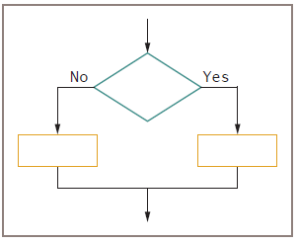
Boolean Expressions and the Selection Structure (cont.)
Dual-alternative (or binary) selection structure
Provides an action for each of two possible outcomes
Figure 4-1 The dual-alternative selection structure

Slide 5
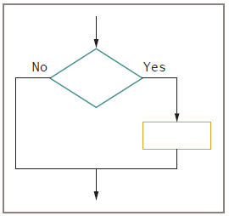
Boolean Expressions and the Selection Structure (cont.)
Single-alternative (or unary) selection structure
Action is provided for only one outcome
if-then
General Syntax of “if statement”:
if (condition)
{
//Block of C statements here
//These statements will only execute if the condition is true
}
Figure 4-2 The single-alternative selection structure

Slide 6
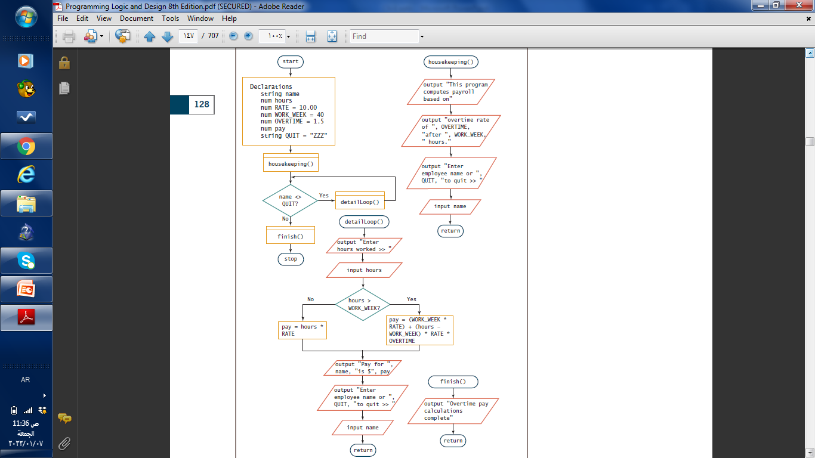
Figure 4-3 Flowchart and pseudocode for overtime payroll program

Slide 7
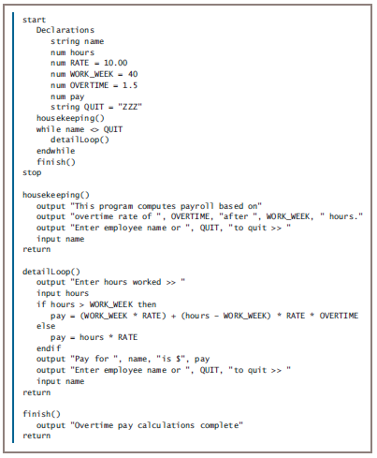
Figure 4-3 Flowchart and pseudocode for overtime payroll program (continued)

Slide 8
Boolean Expressions and the Selection Structure (cont.)
If Statement Example:
#include <stdio.h>
int main ()
{
/* local variable definition */
int a = 10;
/* check the Boolean condition using if statement */
if( a < 20 ) {
/* if condition is true then print the following */
printf("a is less than 20\n" );
}
printf("value of a is : %d\n", a);
return 0;
}
if-then-else decision
if-then clause
Holds the action or actions that execute when the tested condition in the decision is true
else clause
Executes only when the tested condition in the decision is false
a is less than 20
value of a is : 10

Slide 9
Using Relational Comparison Operators
Relational comparison operators
Six types supported by all modern programming languages
Two values compared can be either variables or constants
Trivial expressions
Will always evaluate to the same result
Examples:
true for 20 = 20?
false for 30 = 40?

Slide 10
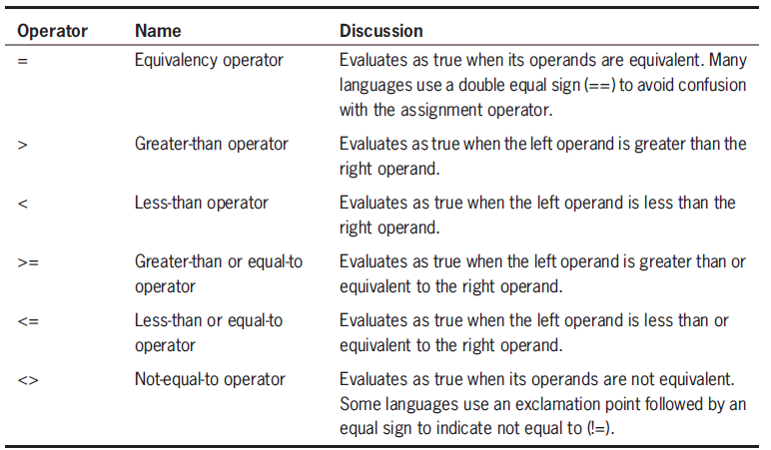
Table 4-1 Relational comparison operators

Slide 11
Using Relational Comparison Operators (cont.)
Any decision can be made with only three types of comparisons: =, >, and <
The >= and <= operators are not necessary but make code more readable
“Not equal” operator
Involves thinking in double negatives
Best to restrict usage to “if without an else”—that is, only take action when some comparison is false

Slide 12
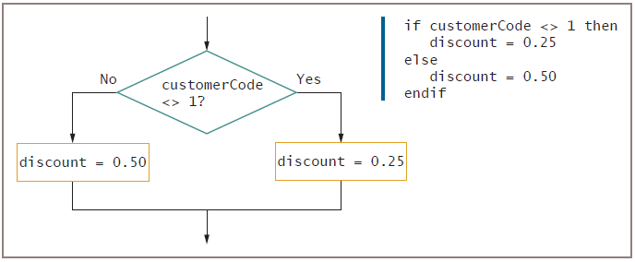
Using Relational Comparison Operators (cont.)
Figure 4-5 Using a negative comparison

Slide 13
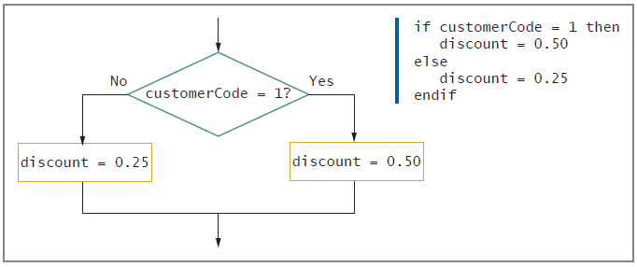
Using Relational Comparison Operators (continued)
Figure 4-6 Using the positive equivalent of the negative comparison in Figure 4-5

Slide 14
Avoiding a Common Error with Relational Operators
Common errors
Using the wrong operator
Missing the boundary or limit required for a selection

Slide 15
Understanding AND Logic
Compound condition
Asks multiple questions before an outcome is determined
For example: you work for a cell phone company that charges customers as follow:
The basic monthly service bill is $30.
An additional $20 is billed to customers who make more than 100 calls that last for a total more than 500 minutes.
The logic needed for this billing program includes an AND decision, decision that test a condition with two parts both of two tests evaluate to true.
AND decision
Requires that both of two tests evaluate to true
Requires a nested decision (nested if) or a cascading if statement

Slide 16
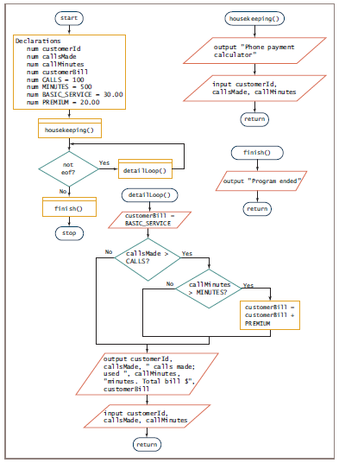
Figure 4-7 Flowchart and pseudocode for cell phone billing program

Slide 17
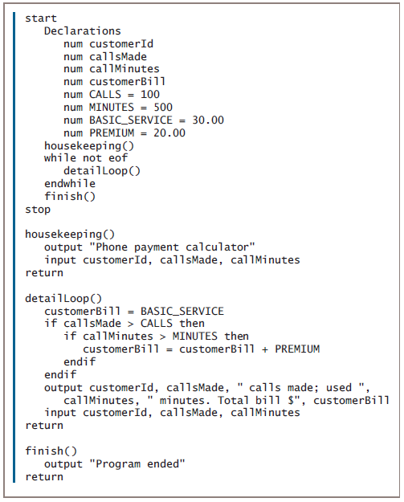
Figure 4-7 Flowchart and pseudocode for cell phone billing program (continued)

Slide 18
Nesting AND Decisions for Efficiency
When nesting decisions
Either selection can come first
Performance time can be improved by asking questions in the proper order
In an AND decision, first ask the question that is less likely to be true
Eliminates as many instances of the second decision as possible
Speeds up processing time

Slide 19
Using the AND Operator
Conditional AND operator
Ask two or more questions in a single comparison
Each Boolean expression must be true for entire expression to evaluate to true
Truth tables
Describe the truth of an entire expression based on the truth of its parts
Short-circuit evaluation
Expression evaluated only as far as necessary to determine truth

Slide 20
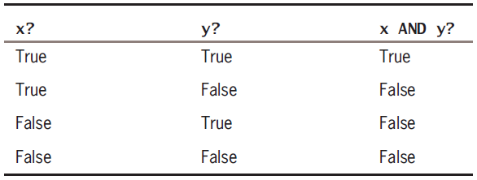
Using the AND Operator (continued)
Table 4-2 Truth table for the AND operator

Slide 21
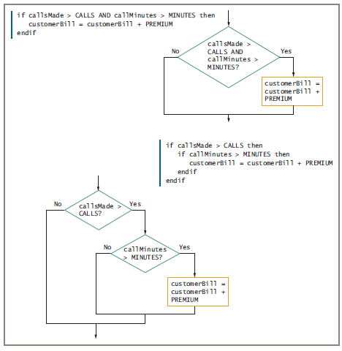
Figure 4-9 Using an AND operator and the logic behind it

Slide 22
Avoiding Common Errors in an AND Selection
Second decision must be made entirely within the first decision
In most programming languages, logical AND is a binary operator
Requires a complete Boolean expression on both sides

Slide 23
Understanding OR Logic
OR decision
Take action when one or the other of two conditions is true
Example
“Are you free for dinner Friday or Saturday?”

Slide 24
Writing OR Decisions for Efficiency
May ask either question first
Both produce the same output but vary widely in number of questions asked
If first question is true, no need to ask second
In an OR decision, first ask the question that is more likely to be true
Eliminate as many extra decisions as possible

Slide 25
Using the OR Operator
Conditional OR operator
Ask two or more questions in a single comparison
Only one Boolean expression in an OR selection must be true to produce a result of true
Question placed first will be asked first
Consider efficiency
Computer can ask only one question at a time

Slide 26
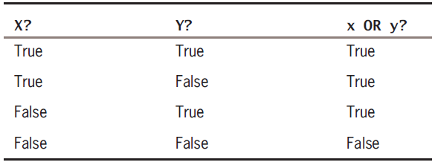
Using the OR Operator (continued)
Table 4-3 Truth table for the OR operator

Slide 27
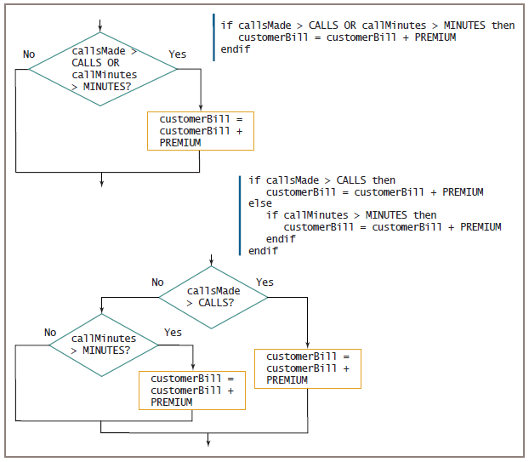
Figure 4-13 Using an OR operator and the logic behind it

Slide 28
Avoiding Common Errors in an OR Selection
Second question must be a self-contained structure with one entry and exit point
Request for A and B in English logically means a request for A or B
Example
“Add $20 to the bill of anyone who makes more than 100 calls and to anyone who has used more than 500 minutes”
“Add $20 to the bill of anyone who has made more than 100 calls or has used more than 500 minutes”

Slide 29
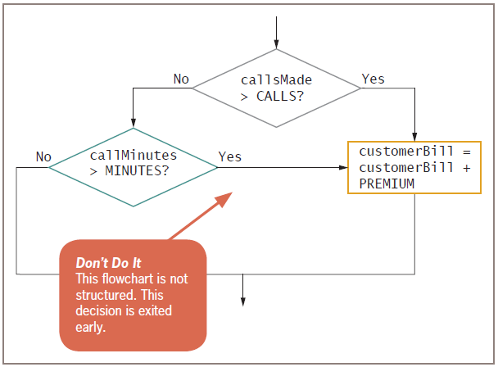
Avoiding Common Errors in an OR Selection (cont.)
Figure 4-14 Unstructured flowchart for determining customer cell phone bill

Slide 30
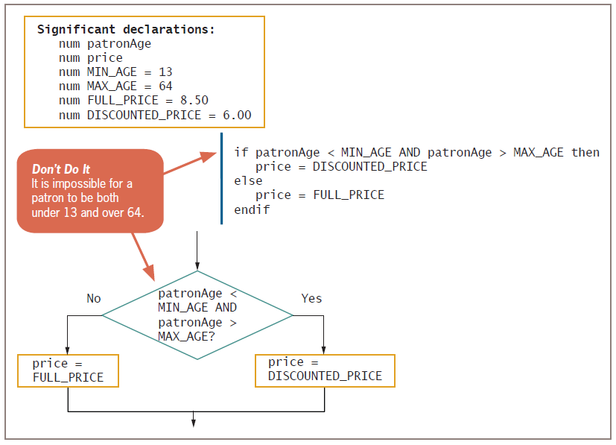
Avoiding Common Errors in an OR Selection (continued)
Figure 4-15 Incorrect logic that attempts to provide a discount for young and old movie patrons

Slide 31
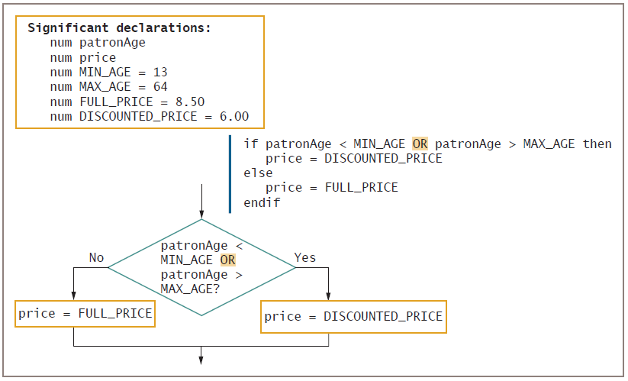
Avoiding Common Errors in an OR Selection (continued)
Figure 4-16 Correct logic that provides a discount for young and old movie patrons

Slide 32
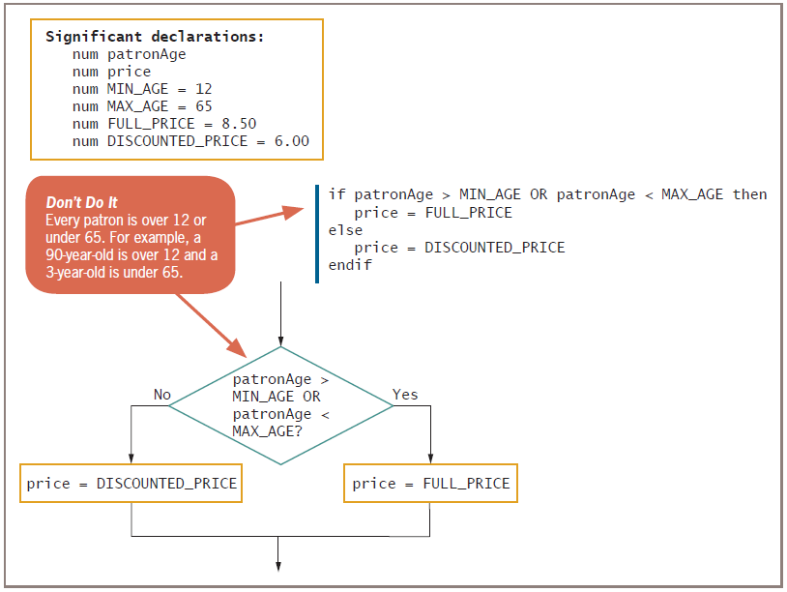
Avoiding Common Errors in an OR Selection (continued)
Figure 4-17 Incorrect logic that attempts to charge full price for patrons whose age is over 12 and under 65

Slide 33
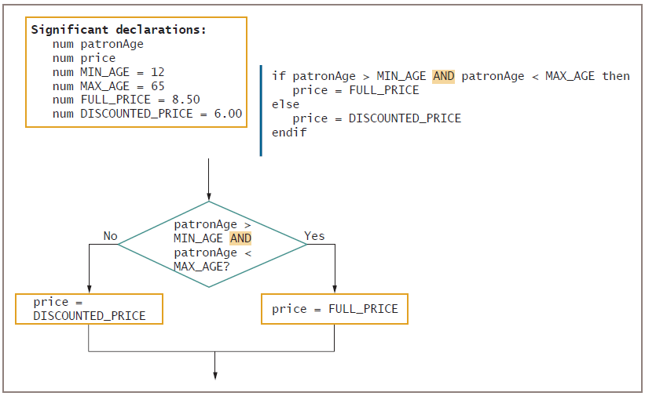
Avoiding Common Errors in an OR Selection (continued)
Figure 4-18 Correct logic that charges full price for patrons whose age is over 12 and under 65

Slide 34
Making Selections within Ranges
Range check
Compare a variable to a series of values between limits
Use the lowest or highest value in each range
Adjust the question logic when using highest versus lowest values
Should end points of the range be included?
Yes: use >= or <=
No: use < or >

Slide 35
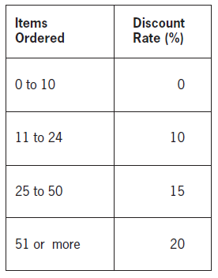
Making Selections within Ranges (continued)
Figure 4-19 Discount rates based on items ordered

Slide 36
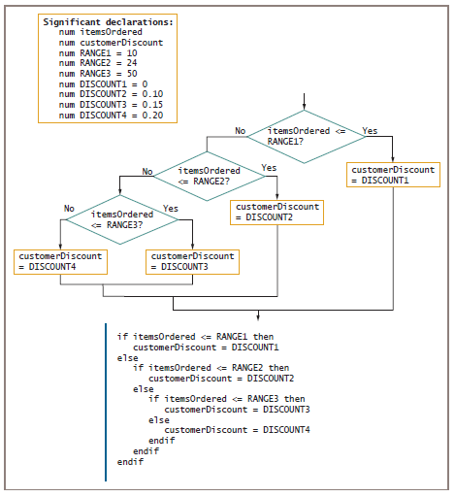
Figure 4-20 Flowchart and pseudocode of logic that selects correct discount based on items

Slide 37
Avoiding Common Errors When Using Range Checks
Avoid a dead or unreachable path
Don’t check for values that can never occur
Requires some prior knowledge of the data
Never ask a question if there is only one possible outcome
Avoid asking a question when the logic has already determined the outcome

Slide 38
Understanding Precedence When Combining AND and OR Operators
Combine multiple AND and OR operators in an expression
When multiple conditions must all be true, use multiple ANDs
if score1 >= MIN_SCORE AND score2 >= MIN_SCORE AND score 3 >= MIN_SCORE then
classGrade = "Pass"
else
classGrade = "Fail"
endif

Slide 39
Understanding Precedence When Combining AND and OR Operators (cont’d)
When only one of multiple conditions must be true, use multiple ORs
if score1 >= MIN_SCORE OR score2 >= MIN_SCORE OR score3 >= MIN_SCORE then
classGrade = "Pass"
else
classGrade = "Fail"
endif

Slide 40
Understanding Precedence When Combining AND and OR Operators (cont’d)
When AND and OR operators are combined in the same statement, AND operators are evaluated first
if age <= 12 OR age >= 65 AND rating = "G"
Use parentheses to correct logic and force evaluations to occur in the order desired
if (age <= 12 OR age >= 65) AND rating = "G"

Slide 41
Understanding Precedence When Combining AND and OR Operators (cont’d)
Mixing AND and OR operators makes logic more complicated
Can avoid mixing AND and OR decisions by nesting if statements

Slide 42
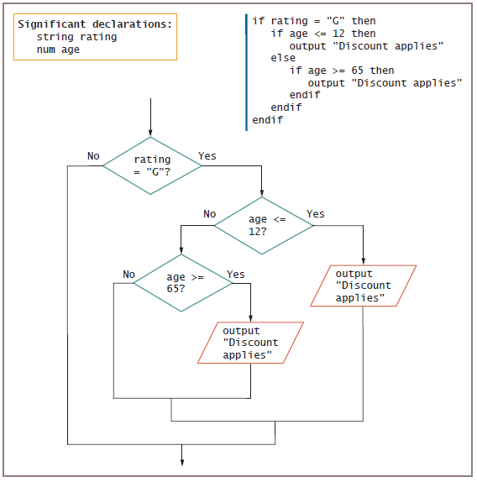
Figure 4-23 Nested decisions that determine movie patron discount

Slide 43
Summary
Decisions involve evaluating Boolean expressions
Use relational operators to compare values
An AND decision requires that both conditions be true to produce a true result
In an AND decision, first ask the question that is less likely to be true
An OR decision requires that either of the conditions be true to produce a true result

Slide 44
Summary (continued)
In an OR decision, first ask the question that is more likely to be true
For a range check:
Make comparisons with the highest or lowest values in each range
Eliminate unnecessary or previously answered questions
The AND operator takes precedence over the OR operator

Slide 45
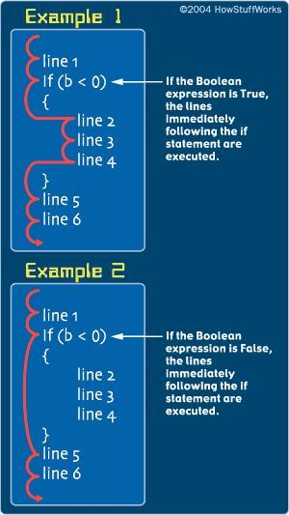
In this Program, you’ll learn how to Reverse a Sentence Using Recursion.
To properly understand this Program to Reverse a Sentence Using Recursion you should know the following:
C Functions; C User-defined functions; C Recursion
The below Program takes the input from the user and displays it in reverse order.
Program to Reverse a Sentence Using Recursion
#include <stdio.h>
void reverse();
void main()
{
printf("Please enter a sentence: ");
reverse();
}
void reverse()
{
char c;
scanf("%c", &c);
if (c != '\n')
{
reverse();
printf("%c", c);
}
}
Notes:
Output: Please Enter the Sentance: margorp emosewa awesome program

Slide 46
C Program to Print an Integer in Just 3 Lines of Code
The variable is displayed on the screen using printf( ) function.
Data types in C language:
for integers, it is int, for characters it is char, for floating point data it’s float and so on. For large integers, you can use long or long long data type. To store integers which are larger than (2^18-1) which is the range of long long data type you may use strings. In the below program we store an integer in a string and then display it.
#include <stdio.h>
int main()
{
int number; // printf() dislpays the formatted output
printf("Enter an integer: "); // scanf() reads the formatted input and stores them scanf("%d", &number); // printf() displays the formatted output
printf("You entered: %d", number);
return 0; Output: Enter a integer: 35
} You entered: 35
Notes:
C Program to find the Average of 5 Subjects
#include<stdio.h>
#include<conio.h>
void main()
{
int s1,s2,s3,s4,s5,sum;
float avg;
clrscr();
printf("\n Enter Subject 1 Marks : ");
scanf("%d",&s1);
printf("\n Enter Subject 2 Marks : ");
scanf("%d",&s2);
printf("\n Enter Subject 3 Marks : ");
scanf("%d",&s3);
printf("\n Enter Subject 4 Marks : ");
scanf("%d",&s4);
printf("\n Enter Subject 5 Marks : ");
scanf("%d",&s5);
sum = s1+s2+s3+s4+s5;
printf("\n\n THE SUMATION IS %d ",sum);
avg = sum/5;
printf("\n\n THE AVERAGE IS %.2f",avg);
getch();
}
Output:
Enter Subject 1 Marks : 41
Enter Subject 2 Marks : 58
Enter Subject 3 Marks : 60
Enter Subject 4 Marks : 70
Enter Subject 5 Marks : 60
THE SUMATION IS 289
THE AVERAGE IS 57.00
Related Program:
C Program to Compute Quotient and Remainder
C Program to Find ASCII Value of a Character
C Program to Swap Two Numbers
C Program to Demonstrate the Working of Keyword long
C Program to Find the Size of int, float, double and char
C Program to Multiply two Floating Point Numbers
https://coderforevers.com/c/c-program/find-average-of-subjects/

Slide 47
C Programming Language:
C Programming Language:
The course materials can be found on the:
https://devdocs.io/c/

